Slide 1
Hydrological Risk assessment
Integrated hydrological modelling
V. Guinot
University of Montpellier – Maison des Sciences de l’Eau – 34095 Montpellier Cedex 5
e-mail : guinot@msem.univ-montp2.fr

Slide 2
An outline of this subject
Assessment of hydrological risk : how modelling can help
The existing types of models
Use of the various types of models
Contents of the present subject

Slide 3
Hydrological risk assessment: how modelling can help
The increasing impact of ‘natural’ disasters over the past years is mainly due to social factors (true in particular for floods)
Growing need for impact assessment
- Of extreme events
- Assuming future changes in urbanisation, social patterns, etc.
- From an economical point of view

Slide 4
Hydrological risk assessment: how modelling can help (2)
An obvious answer : modelling
However :
- Extreme events = scarcity of data
- Impact assessment = need for specific types of models

Slide 5
The existing types of models
Empirical (or ‘black box’): fit between inputs and outputs without trying to detailed phenomena analysis (ex. Linear regression, unit hydrograph)
Data
Model

Slide 6
The existing types of models (2)
Lumped conceptual : The main physical compartments of the hydrological cycle are represented by storage entities, without looking at spatial variability of the parameters (ex. NAM)
Surface water
Unsaturated zone
Aquifers

Slide 7
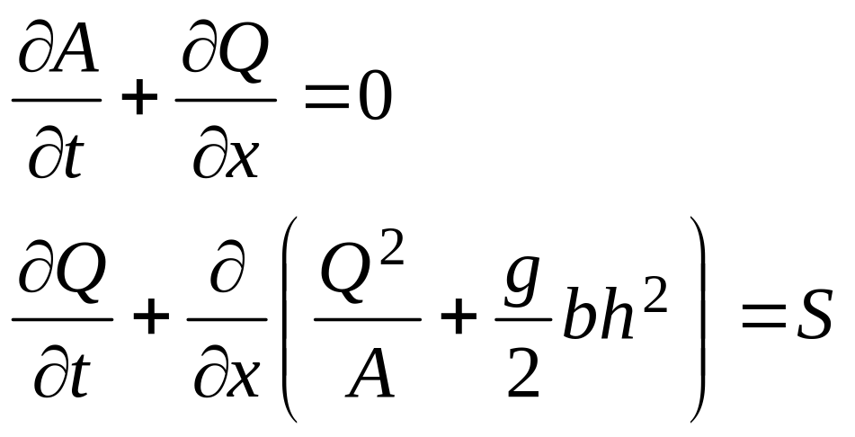
The existing types of models (3)
Physically-based : fluxes of water and solutes are governed by physical laws based on conservation of mass, momentum and formulations for local source terms (ex. Darcy’s law, Saint Venant equations, etc.)

Slide 8
Use of the various types of models
Empirical models : easy to calibrate, very fast, little knowledge of the phenomena involved and of the catchment is needed. Changes in the physics of the basin (new highway, urbanisation, etc.) cannot be modelled !
Lumped, conceptual models : allow for more physical insight into the processes involved over the modelled areas. Very restricted capacity to model changes in the basin.
Physically-based : More geometric and hydraulic data needed. Changes in the physics of the basin can be modelled. Possibility to deal with ungauged catchments !

Slide 9
Contents of the present subject
You will
be briefly introduced to the MIKE SHE modelling system
be given a short description of the various modules that you are going to use
work on a set of tutorials to investigate the various concepts that can be used to model rainfall-runoff mechanisms
Carry out an assessment of hydrological risks over a highly urbanised area

